Slide 1
Fundamentals of Scientific Computing
– AND –
Applied Bioinformatics and Computational Biology
Fall 2020

Slide 2
Zoom Check
audio and video
thumbs up

Slide 3
A1.aa
Course Intro
Sabah Ul-Hasan Credit: Andrew Su

Slide 4
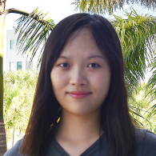
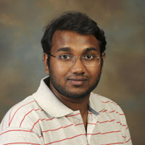
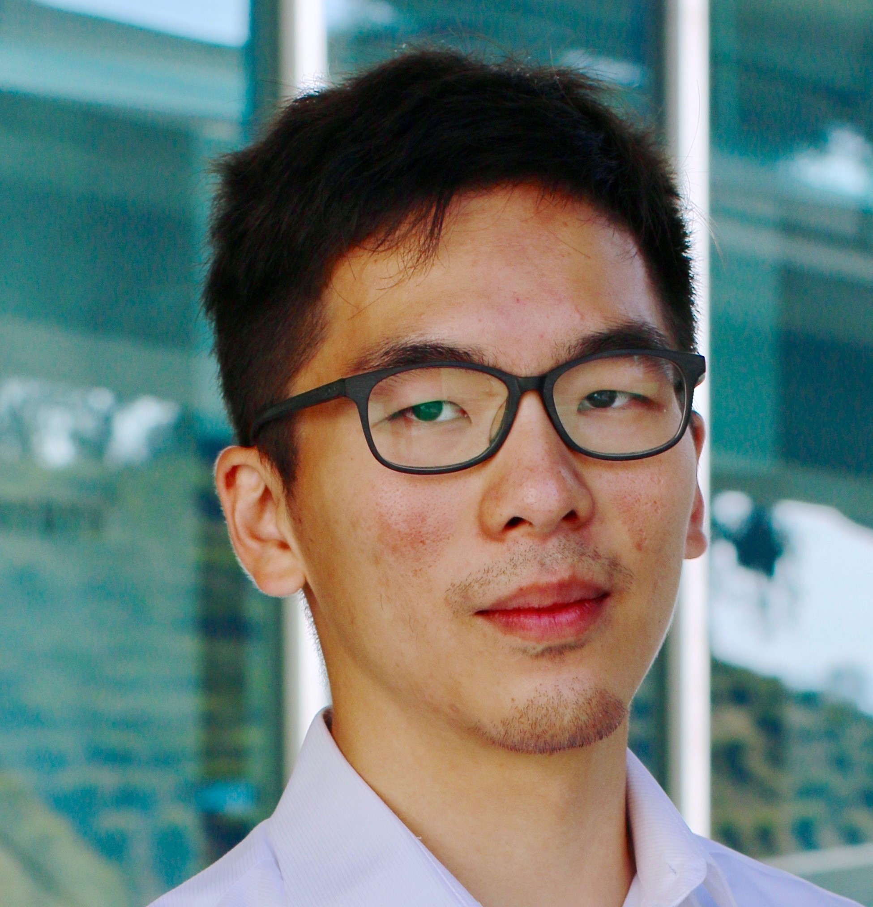
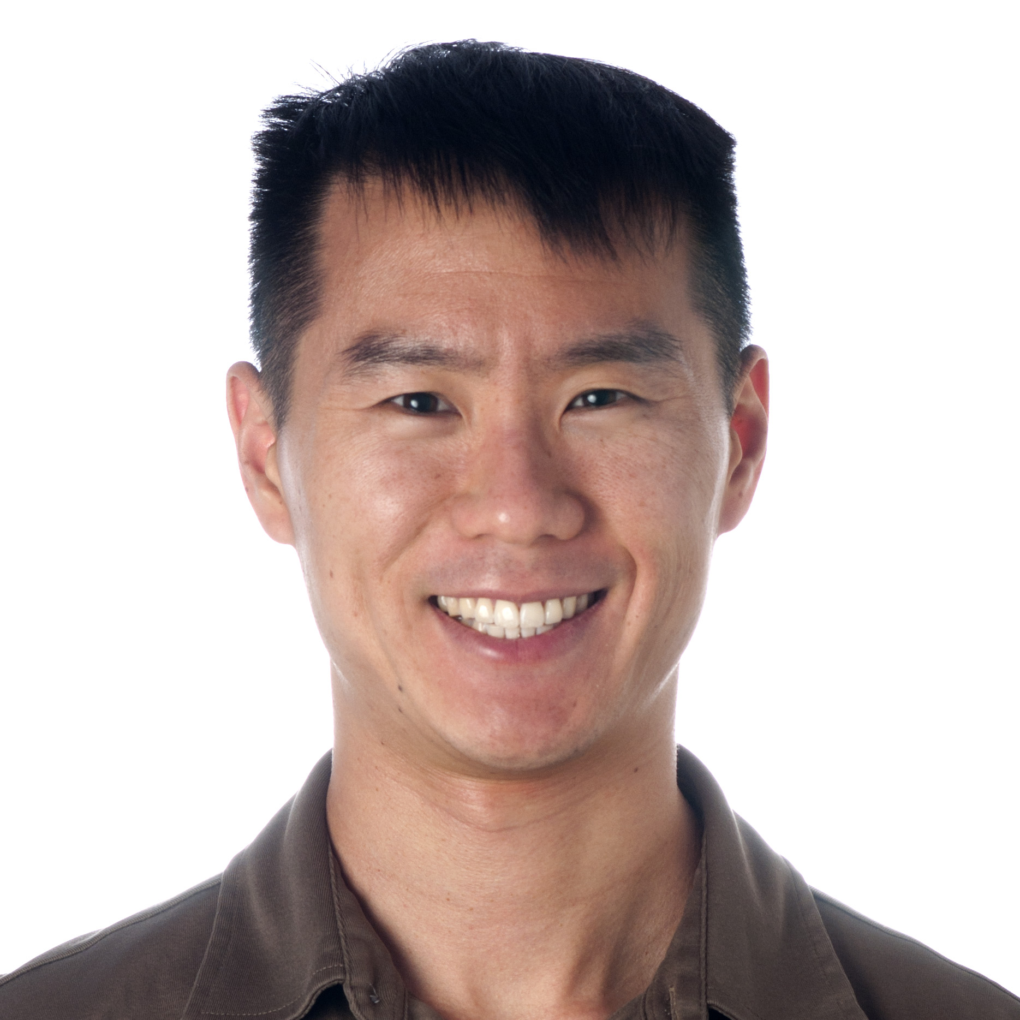
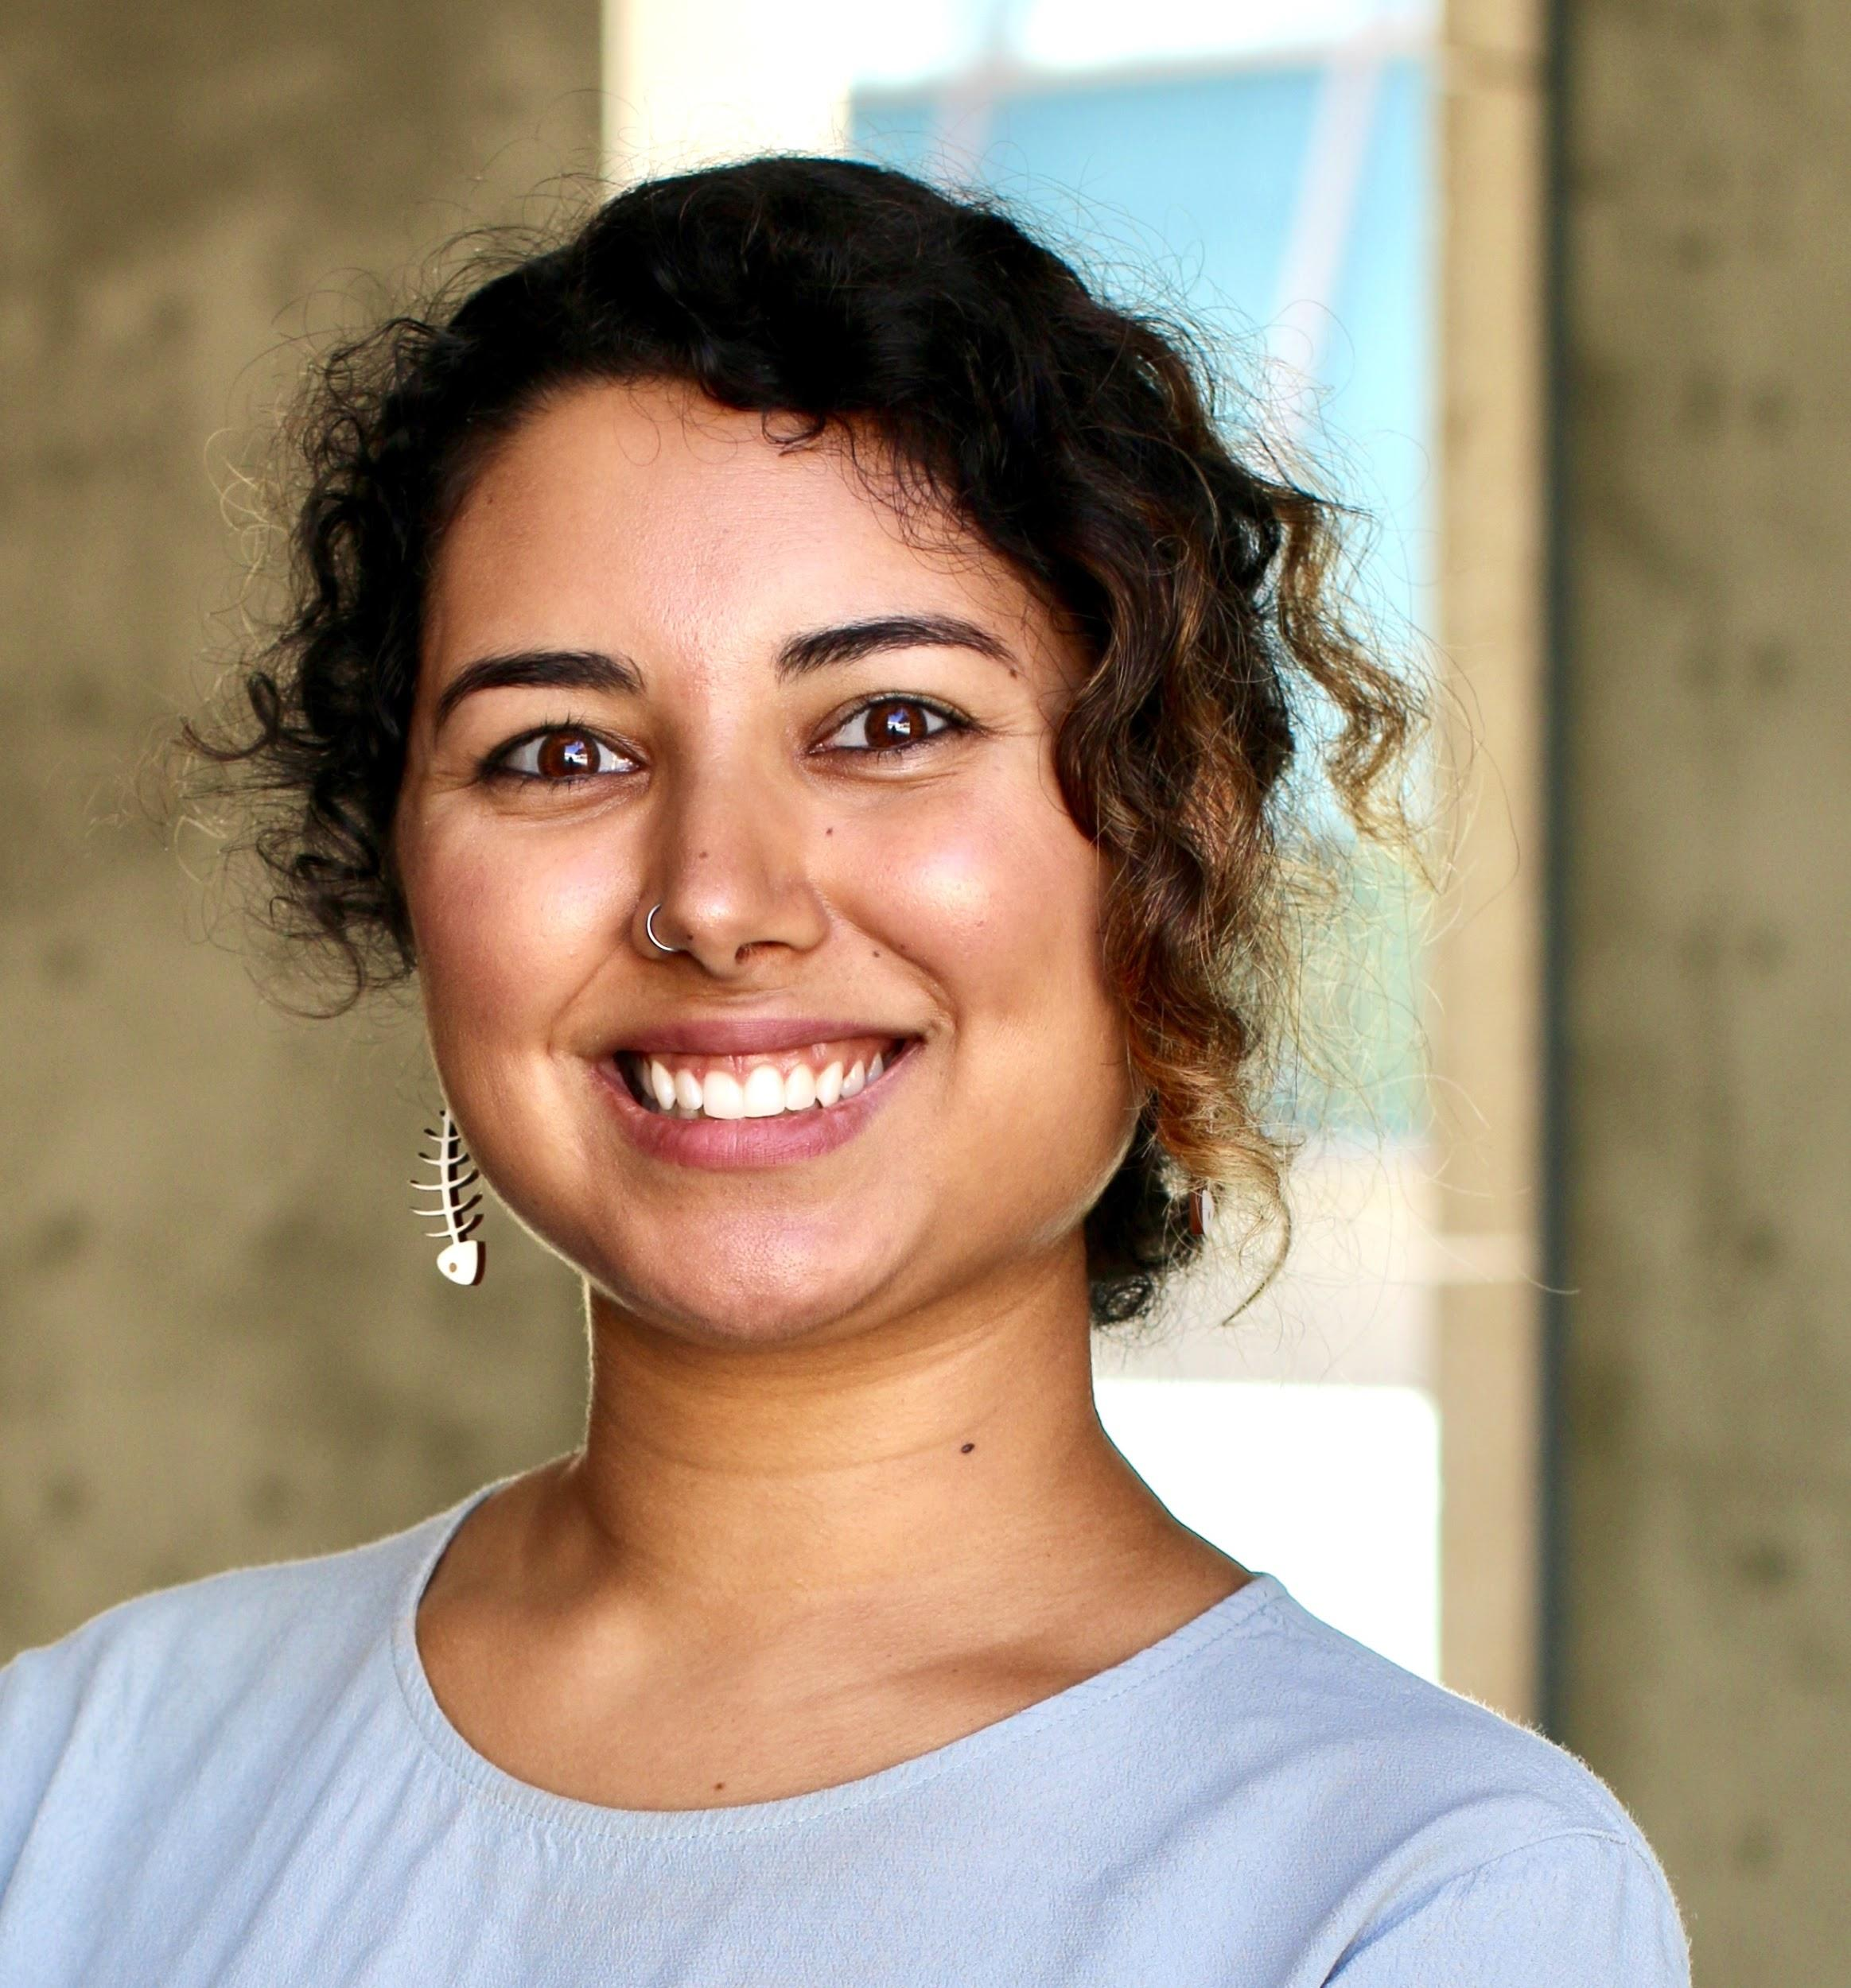
Brief Introductions (30 sec each)
TAs
Course Directors
Huitian Dao
Karthik Gangavarapu
Shang-Fu
Chen
Andrew Su
Sabah Ul-Hasan

Slide 5
What to Expect From Us
Expertise
Mentorship
Professionalism
Communicative
Huitian Dao
Karthik Gangavarapu
Shang-Fu
Chen
Andrew Su
Sabah Ul-Hasan

Slide 6

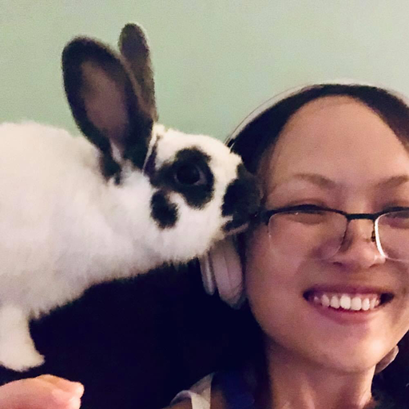
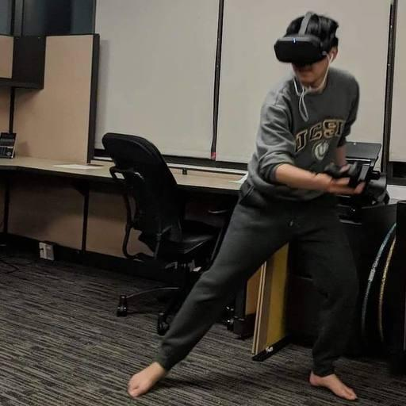
It’s a Pandemic, Afterall
Expertise
Mentorship
Professionalism
Communicative
We’re humans, too (as are you!) We’ll be decompressing during non-business hours
Support of you being your healthiest self
Huitian Dao
Karthik Gangavarapu
Shang-Fu
Chen
Andrew Su
Sabah Ul-Hasan

Slide 7
ABCB Course Structure
https://github.com/SuLab/Applied-Bioinformatics/tree/Fall-2020
Layout: 45 x 45, homeworks are due each Tuesday at 8 AM PST
Fundamentals of Scientific Computing (Unit A, ~4 weeks)
Weeks 1-2 Jupyter, Bash
Weeks 3-5 R
Applied Bioinformatics and Computational Biology (Units B-C, ~8 weeks)
Weeks 5-9 RNA-seq
Weeks 10-12 Capstone Project (tying it all together by reproducing a publication figure)

Slide 8
Course Philosophy

Slide 9
Imagine this as all of bioinformatics

Slide 10

Imagine this as all of bioinformatics
Provide a broad overview of all topics in bioinformatics?

Slide 11
Imagine this as all of bioinformatics
Provide a broad overview of all topics in bioinformatics?
Cover a selection of bioinformatics topics in great depth?

Slide 12



Imagine this as all of bioinformatics
Provide a broad overview of all topics in bioinformatics?
Cover a selection of bioinformatics topics in great depth?
Provide guidance and confidence in your ability to manage and analyze your own data
YOU TODAY

Slide 13
Course Philosophy
This course is not a comprehensive review of bioinformatics
This course is a course to learn applied skills, using a few common bioinformatics analyses as examples
There are many ways to cook an egg We will demonstrate one way

Slide 14
Learning Objectives
Technical
jupyter – analysis notebooks
bash – command line shell
R – language for statistical computing
bioconductor – R libraries for bioinformatics
git and github – version control
Scientific
RNA-seq
Reproducibility
Presentation and Peer Review
NOT covering image analysis, phylogenetics, genetic association, biostatistics, cytoscape, biomedical ontologies, algorithms, ...

Slide 15
Grading (Student Focused)
Fundamentals (Unit A): 50 pts
Participation (20 pts): Zoom and Slack
Homework (3 x 10 pts): Due each Tuesday @ 8 AM PST
Applied Bioinfo (Units B-C): 100 pts
Participation (20 pts): Zoom and Slack
Homework (5 x 10 pts): Due each Tuesday @ 8 AM PST
Capstone (30 pts): 15 pts for content, 10 for presentation, 5 for peer review

Slide 16
Grading (Student Focused)
Fundamentals (Unit A): 50 pts
Participation (20 pts): Zoom and Slack
Homework (3 x 10 pts): Due each Tuesday @ 8 AM PST
Applied Bioinfo (Units B-C): 100 pts
Participation (20 pts): Zoom and Slack
Homework (5 x 10 pts): Due each Tuesday @ 8 AM PST
Capstone (30 pts): 15 pts for content, 10 for presentation, 5 for peer review
Letter Grade - Business per usual
Pass/Fail - Treated similar as Letter Grade (70% or higher)
Audit - Amount of learning up to you, treated same as Letter Grade

Slide 17
Grading (Student Focused)
Fundamentals (Unit A): 50 pts
Participation (20 pts): Zoom and Slack
Homework (3 x 10 pts): Due each Tuesday @ 8 AM PST
Applied Bioinfo (Units B-C): 100 pts
Participation (20 pts): Zoom and Slack
Homework (5 x 10 pts): Due each Tuesday @ 8 AM PST
Capstone (30 pts): 15 pts for content, 10 for presentation, 5 for peer review
Letter Grade - Business per usual
Pass/Fail - Treated similar as Letter Grade (70% or higher)
Audit - Amount of learning up to you, treated same as Letter Grade
Feeling advanced during certain sections? Teaching opportunities!

Slide 18
Participation (20 pts per course)
“Showing up is half the battle”
Each lecture (ie A1.a), Post a thoughtful question on Slack or thoughtfully answer a question asked (no question twice)

Slide 19
Participation (20 pts per course) -- Today, Intros
“Showing up is half the battle”
Each lecture (ie A1.a), Post a thoughtful question on Slack or thoughtfully answer a question asked (no question twice)
Make sure your full name is shown in Slack for TAs to record you name
Unit A 2.5 pts per class = 20 / (2*4 weeks)
Absence: A student can have 1 unexcused and 1 excused (2 total)
Unit B-C 2 pts per weeks 5-9 = 20 / (2*5 weeks)
Absence: A student can have 1 excused absence during weeks 5-9, 2 unexcused weeks 5-12 (3 total)
Note participation points not given for weeks 10-12 due to nature of the topics
Absences can be made-up by sending a 4-6 sentence synopsis from recorded lectures

Slide 20
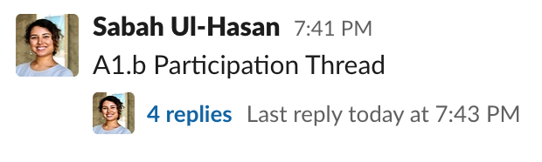
Participation (20 pts per course) -- Today, Intros
“Showing up is half the battle”
Each lecture (ie A1.a), Post a thoughtful question on Slack or thoughtfully answer a question asked (no question twice)

Slide 21
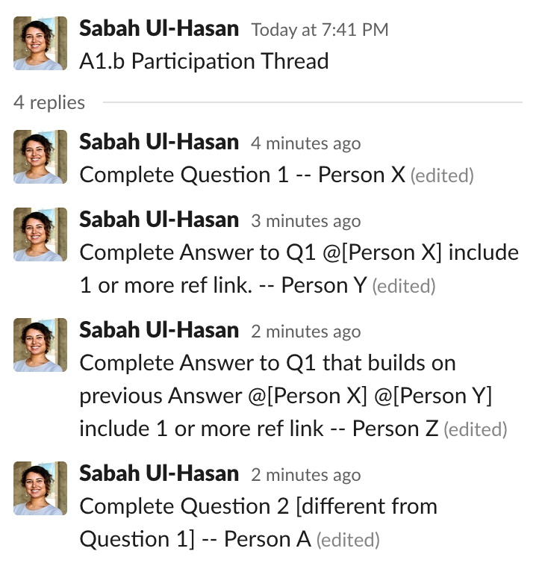
Participation (20 pts per course) -- Today, Intros
“Showing up is half the battle”
Each lecture (ie A1.a), Post a thoughtful question on Slack or thoughtfully answer a question asked (no question twice)

Slide 22

Utilizing Zoom for Participation (Test)
👍
I’m not understanding and need clarification
I understand this

Slide 23
Utilizing Zoom for Participation (Test)
It’s our job to make sure everyone is on the same page, and this is a no-judgement zone. Always ask questions (even the ones that seem ‘dumb’). It’s very likely someone has the same question as you!
👍
I’m not understanding and need clarification
I understand this

Slide 24
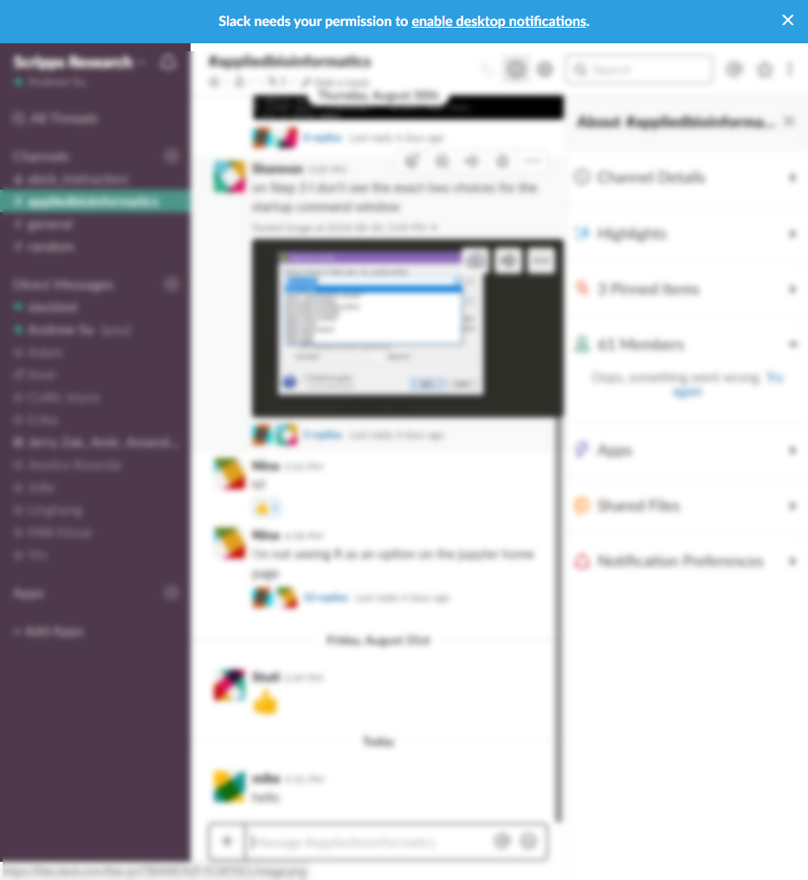
Utilizing Slack for Questions (> Zoom)
https://slack.com/download
Pinned posts = of importance
Reduce chat clutter. If you see a topic/question similar to yours, reply to it as a thread > reply
Write your question(s) as one full set > multiple entries after another to reduce notifications

Slide 25
Homework (10 pts each)
Breakdown per assignment: 2*3 + 4 = 10 pts
Tue (aa + ab), and Thu (ba) = ~2 pts each
Thu (bb) = 4 pts each
Each homework has up to 12 points, but you can only receive 10 points ( this intended to help you :) )
Submit entire assignment as complete before the next Tue @ 8 AM PST
The majority will be autograded, and some graded manually

Slide 26
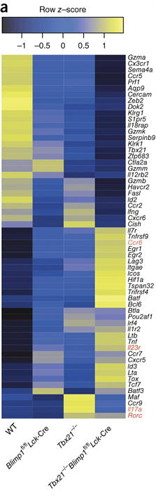
Capstone Project (30 pts) In-Depth in Week 5
Xin et al. 2016 Nat Immunol

Slide 27
Capstone Project (30 pts) In-Depth in Week 5
Content 15 pts
Visual 5 pts
Organization 5 pts
Accuracy 5 pts
Presentation 10 pts
Group effort (3-4 ppl) 5 pts
Quality 5 pts
Peer Review 5 pts
Comments per 2 assigned groups 2*2.5 pts
One for Tue, one for Thu of Week 12
Xin et al. 2016 Nat Immunol

Slide 28
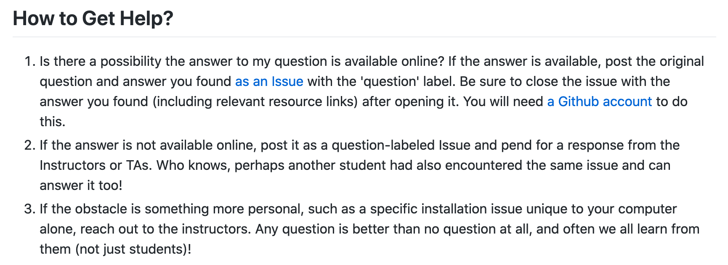
Utilizing Github, Slack (quick questions), and email

Slide 29
Academic Integrity
Reasonable
Discussing assignments and course material
Helping a classmate find a bug in their code
Showing your program to a classmate to help you find a problem in your code
Using online resources to solve assignments, so long as they're not solutions to the assigned problems
Whiteboarding solutions to assignments with others using diagrams or pseudocode but not actual code
Unreasonable
Viewing a classmate's solution in order to solve your assignment
Giving your assignment solution to another student
Starting with someone else's code and making changes to personalize it
Submitting work from a previous course/project as your final project

Slide 30
This class strives to maintain a welcoming environment for learners of all levels and backgrounds
Notes:
Want to know if you encounter unwelcoming behavior outside or inside classroom

Slide 31
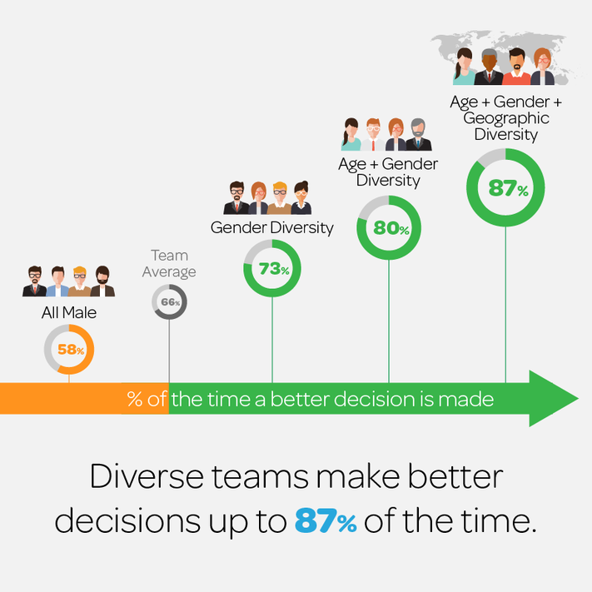
Infographic Credit
Forbes
Diversity in STEM: What It Is and Why It Matters Dr. Kenneth Gibbs (NIH) Scientific American article
Diversity is critical to excellence
Lack of diversity represents a loss of talent
Enhancing diversity is key to long-term economic growth and global competitiveness

Slide 32
Infographic Credit
Forbes
Diversity in STEM: What It Is and Why It Matters Dr. Kenneth Gibbs (NIH) Scientific American article
Diversity is critical to excellence
Lack of diversity represents a loss of talent
Enhancing diversity is key to long-term economic growth and global competitiveness
Questions to be asking yourself during this course 1. Am I being honest with my own biases, which will also benefit my ability to identify biases in the data? 2. Am I being open-minded to different perspectives, giving space for others to share the discussion? 3. What are ways I can be more directly inclusive in how I conduct my science today and going forward?

Slide 33
See something? Say something.
It’s our job create a conducive learning environment for you, and doing so benefits everyone (including us)
Notes:
Want to know if you encounter unwelcoming behavior outside or inside classroom

Slide 34
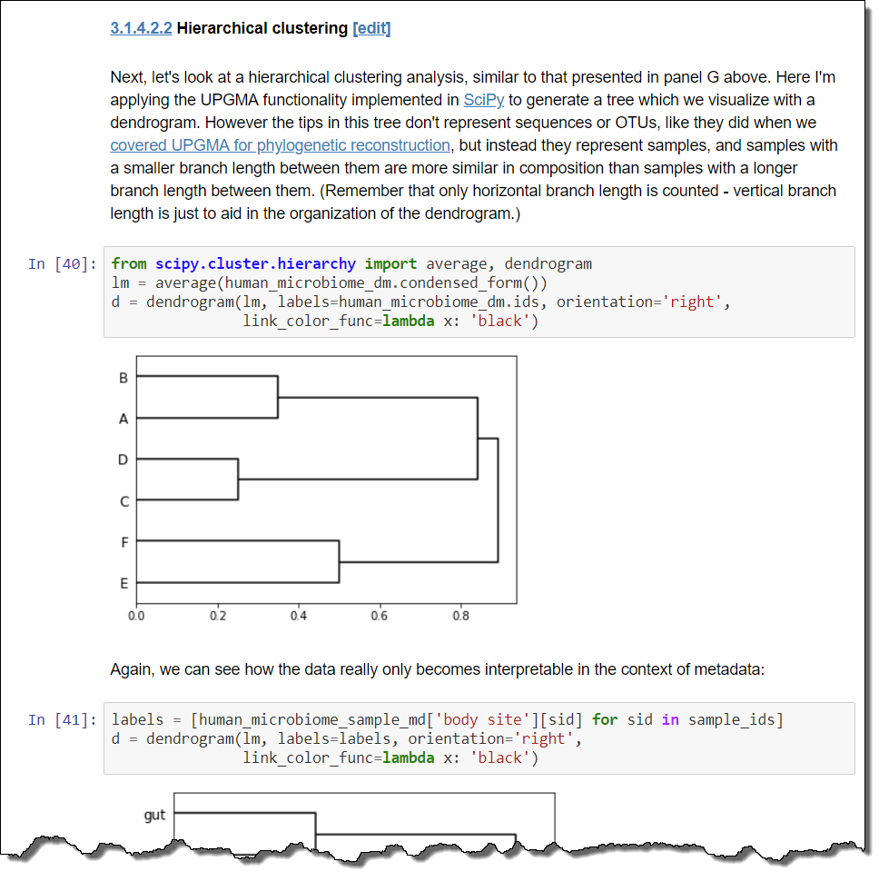
Why Jupyter?
Documentation
+
Code
+
Output
in an executable format
example from: http://readiab.org/book/latest/3/1.html#4.2.2

Slide 35
The (primary) States of Jupyter
Edit mode
(click in edit area)
Code cells
Command mode
(click out of edit area)
Markdown cells
Rendered mode
(control/shift/alt-enter)
Practice using Jupyter Keyboard Shortcuts

Slide 36
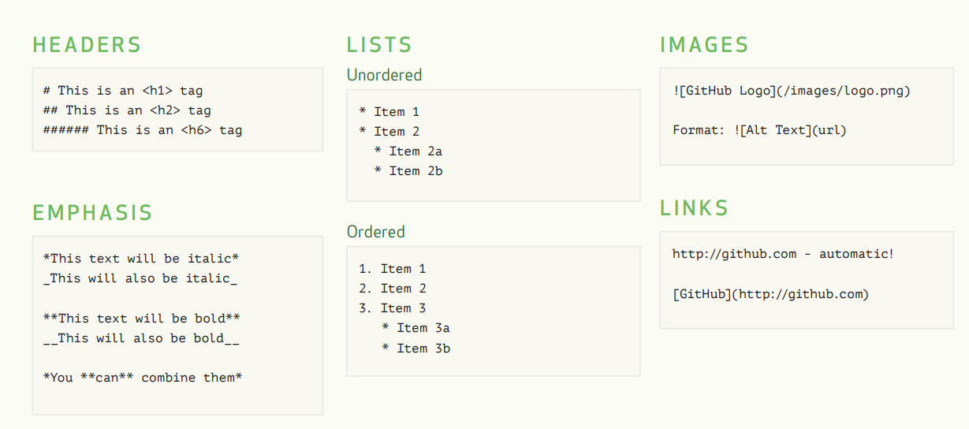
Markdown Cells
Full Docs: https://jupyter-notebook.readthedocs.io/en/stable/examples/Notebook/Working%20With%20Markdown%20Cells.html
Excerpt from https://guides.github.com/pdfs/markdown-cheatsheet-online.pdf

Slide 37
doing work
getting/submitting homeworks
jupyter (locally)
yes, access via local "terminal"
no
jupyterhub
yes, but need to be on campus or via VPN
yes

Slide 38
Demo Time every time you see this color slide, it means we’re switching over to Hands-on exercises

Slide 39
Congratulations on being
the first class every at TSRI to use
Jupyter Hub and nbgrader
(share screen)
http://jupyterhub-abcb.scripps.edu/
Use VPN to access

Slide 40

Congratulations on being
the first class every at TSRI to use
Jupyter Hub and nbgrader
(share screen)
http://jupyterhub-abcb.scripps.edu/
Use VPN to access

Slide 41
Let’s try it! in chronological order
[ ] Access HW 1 (from Github, on your personal computer)
[ ] Confirm you’ve turned on ‘watch releases’ for our 2020 repo [ ] Complete A1.aa tasks on your own
[ ] Copy / paste these to jupyterhub, and save (confirm login)
[ ] Enable Slack, access abcb-2020 post your introduction *update name and picture, if needed
[ ] Enable Canvas notifications, post same sentence in forum

Slide 42
A1.ab
Bash Basics
Andrew Su Credit: Huitian Dao and Sabah Ul-Hasan

Slide 43
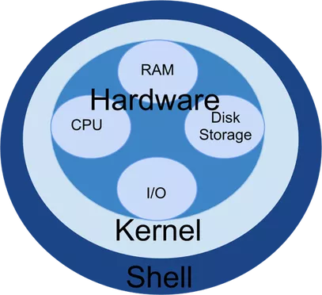
Concepts
Shell is a user interface for access to an operating system's services
Bash is a popular shell for Unix/Linux systems
A command-line interface (CLI) is how users control a system with commands (via text)
In contrast, a graphical user interface (GUI) provides user control using graphical icons
Advanced: Why All Developers Should Learn Command Line

Slide 44
Launching a Shell Through a Terminal
On a Mac, spotlight search for “terminal”
On Windows 10, windows search for “ubuntu” or launch cmder
asu@LAPTOP-LBU6JGIM:~/Applied-Bioinformatics$
username
Computer name
Current directory
Advanced: How to Customize (and Colorize) Your Bash Prompt

Slide 45
Structure of A Command (Demo for 3 min)
[command] [options] [arguments]
$ cat -n test.fasta
$ ls -l *.txt
$ grep -c ‘^>’ test.fasta
$ gzip -cd gene_info.gz

Slide 46
Your First Five Commands
cd – change directory
ls – list directory contents
pwd – print working directory
less – examine file contents
grep – search file contents

Slide 47
More on Bash Scripting (quick references)
Mac terminal cheatsheet (applies to most terminal programs)
Bash cheatsheet
Less navigation cheatsheet

Slide 48
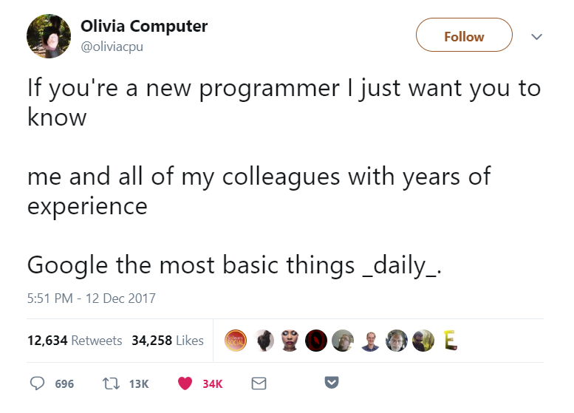
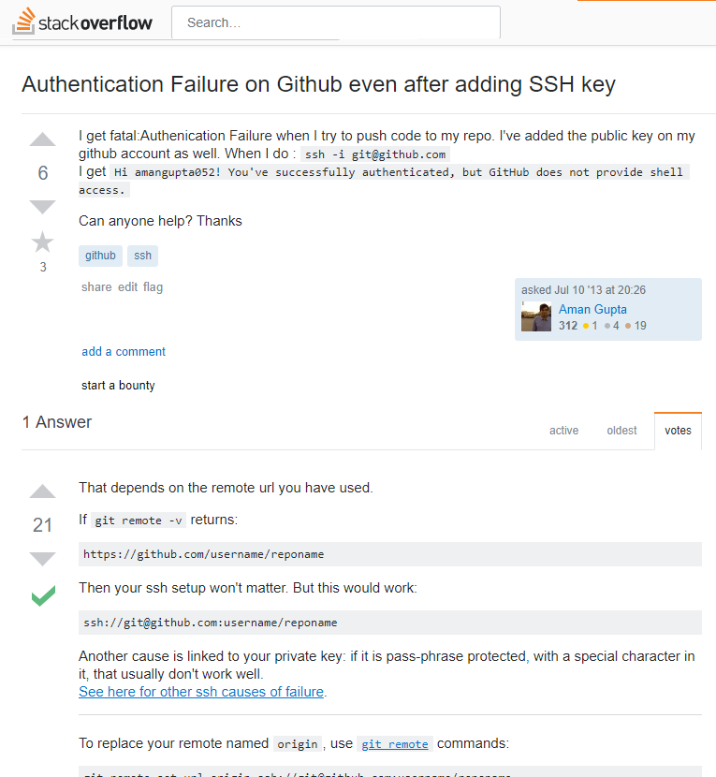
Where to get help?
Using the --help option in terminal
e.g., ls --help
Using the man pages (“manual”) in terminal
e.g., man ls
Google
e.g., ls sort by recently modified
Common useful sites: Stack Overflow, Stack Exchange
Slack and Github Issues

Slide 49
How to ask for help?
Reduce the complexity of the problem to the minimum required to reproduce the error
Post the code necessary to produce the error and all error messages
Describe the process you’ve carried out to solve the problem yourself
Describe your computing environment (e.g., operating system, software versions)

Slide 50
Let’s try it!
[ ] Complete A1.ab tasks of HW 1 as think-pair-share (breakouts) [ ] Are you able to execute all five of the basic commands?
[ ] Try the rest on your own prior to Thu, what was helpful vs not?

Slide 51
Zoom Poll
How are you feeling about ABCB now that we’ve gone through the first day?
Good. Worried.
Underwhelmed.
Overwhelmed. Excited!
Notes:
Want to know if you encounter unwelcoming behavior outside or inside classroom

